Slide 1

Green Pace
Security Policy Presentation
Developer: Andrew Wepplo

Slide 2

OVERVIEW: DEFENSE IN DEPTH
[

Slide 3
THREATS MATRIX
Likely STD-002-CPP STD-005-CPP STD-007-CPP | Priority P3 P18 P6
Low priority P4 P4 | Unlikely STD-001-CPP STD-010-CPP

Slide 4
10 PRINCIPLES
1. Validate Input Data
2. Heed Compiler Warnings
3. Architect and Design for Security Policies
4. Keep It Simple
5. Default Deny
6. Adhere to the Principle of Least Privilege
7. Sanitize Data Sent to Other Systems
8. Practice Defense in Depth
9.Use Effective Quality Assurance Techniques
10. Adopt a Secure Coding Standard
1. Data Type
2. Data Value
3. String Correctness
4. SQL Injection
5. Memory Protection
6. Assertions
7. Exceptions
8. Data Sanitization
9. Dangling Pointer
10. Proper Naming

Slide 5
CODING STANDARDS
STD-001-CPP – Data Type– P4
STD-002-CPP – Data Value – P3
STD-003-CPP – String Correctness – P6
STD-004-J – SQL injection– P12
STD-005-CPP – Memory Protection– P18
STD-006-C – Assertions – P8
STD-007-CPP – Exceptions – P6
STD-008-CPP – Overflows – P4
STD-009-CPP – Access Permissions – P4
STD-010-CPP – Close Files – P4

Slide 6
ENCRYPTION POLICIES
In Rest – Encrypting data that is stored on a disk or other drive. If an attacker obtains access to an encrypted drive and doesn’t have the keys, they can’t access it.
At Flight – This is the process of encrypting data while being transmitted, this would apply to all data between servers and devices that could be compromised.
In Use - This is securing data by ensuring it’s never left vulnerable. This would include using permission-based roles in order to mitigate attacks on data in use.

Slide 7
TRIPLE-A POLICIES
Authentication – Authenticating users via usernames, passwords and other mechanisms applies when utilizing standards of default deny and permission-based coding.
Authorization – This follows authentication and is a second layer of authorizing a user for a particular set of tasks and access to relevant data. This ensures that something is not modified by someone that should not have access to it, and it also applies to useful coding standard practice.
Accounting - This keeps track of all the resources used by the users in the system. It can help keep track of things like, the length of their session or what data was sent and received. This is important for analysis and keeping a secure log of activity.

Slide 8
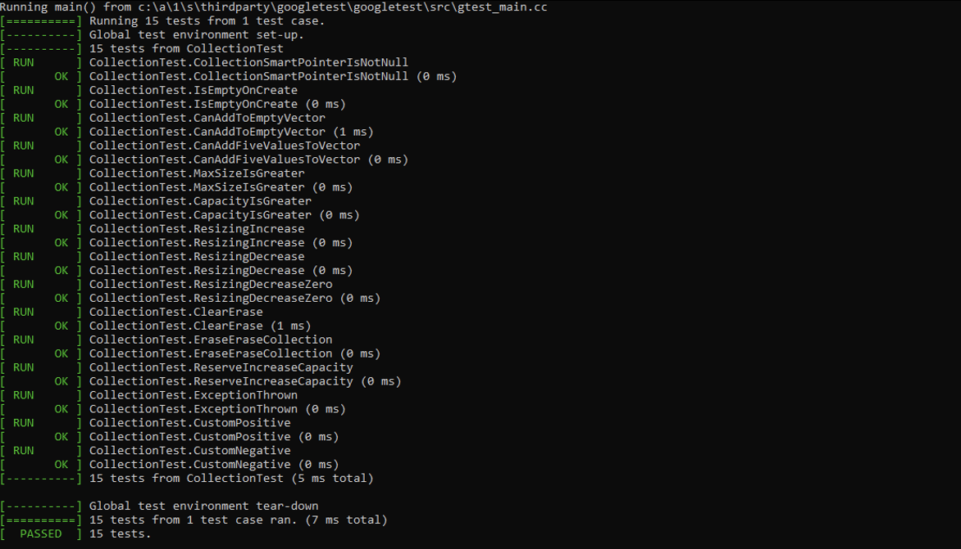
Unit Testing
Shown here is a screenshot of the successful results of running exceptions

Slide 9

AUTOMATION SUMMARY

Slide 10
TOOLS
The DevOps process shown here for Green Pace can be automated at the Transition and health check phase of the production cycle. This step in the policy is where recently verified and tested settings are prepared for deployment and the specific security settings can be pre setup and automated by pushing updates with those rules in place. In addition, if a penetration testing lab is used and was automated to repetitively test these new guidelines, and it would not have to be done manually and have a chance of problems with human error. Lastly, the system would begin by closing necessary ports, blocking IPs, and turning off services when needed, and that would make the job of the response team easier to be able to monitor the system for penetration.

Slide 11
RISKS AND BENEFITS
The strategies should be implemented now while development is being planned in order to best replicate the DevSecOps pipeline and properly integrate best security practices within functional code. The benefits ultimately lead to less time on remediation, lower costs on maintenance, and a better end-user experience.

Slide 12
RECOMMENDATIONS
The policy should be expanded upon as the final product continues to grow, develop and utilize new technologies over time.
All standards and expanded rules should be referenced and included in the DevSecOps pipeline as they become relevant to pieces of functionality that exist within the program.

Slide 13
CONCLUSIONS
Practical coding standards should be implemented going forward to prevent problems in the future due to the scalable nature of software development.
The coding standard reference sheet should be reviewed and updated in meetings throughout the lifecycle to ensure proper implementations of new functionalities.

Slide 14
REFERENCES
Shrum, S. and Schiela, R., (2017). 1 Front Matter - SEI CERT C++ Coding Standard - Confluence. Wiki.sei.cmu.edu. Retreived from. https://wiki.sei.cmu.edu/confluence/display/c

